Slide 1
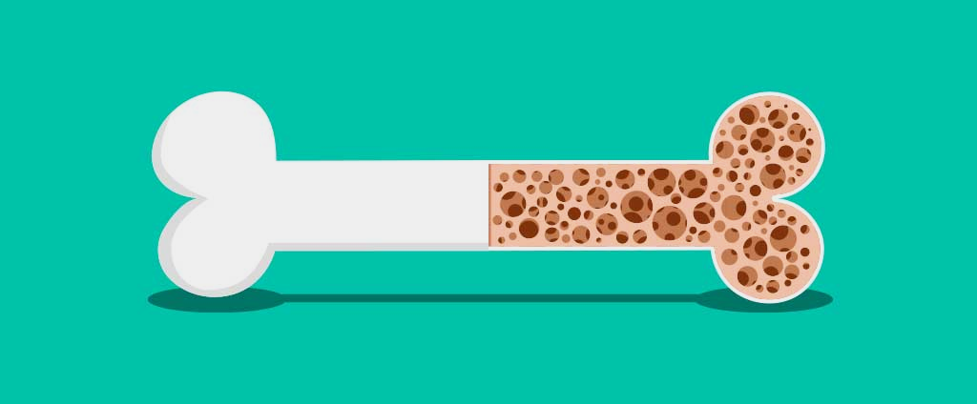
Osteoporosis Predictor
By: Abanob Elias, Nathan Pentecost, Bohdan Tkachov

Slide 2
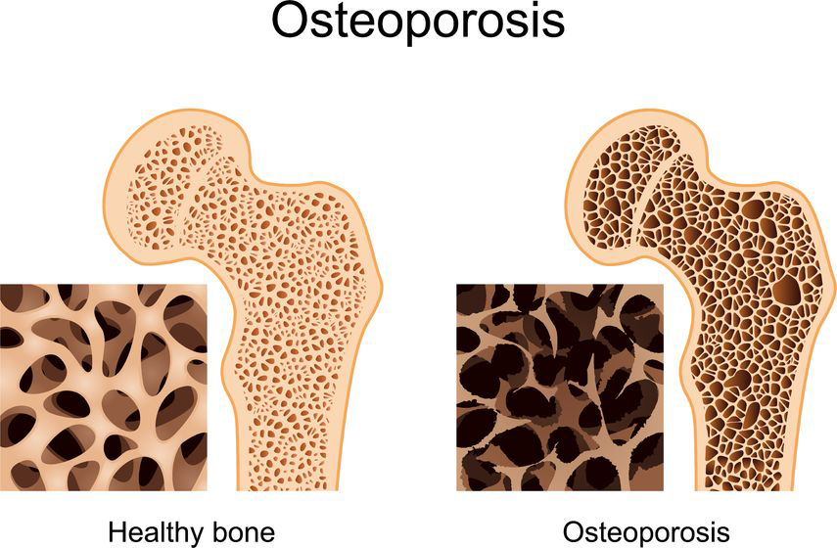
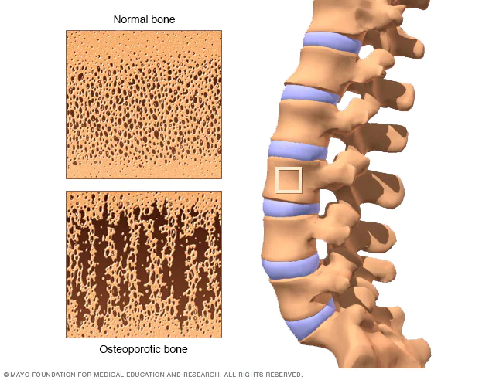
Introduction - Problem Description/Motivation:
Osteoporosis is a degenerative disease where one's bones become brittle and fragile.
Approximately 10 million Americans have osteoporosis and another 44 million have low bone density, placing them at increased risk. [1]
One can develop osteoporosis from a variety of external and internal factors, some of which are predictors.
Current methods are expensive, time consuming, and complex
Often too late when a patient is diagnosed with osteoporosis
Goal is to develop alternative assessment methods to spread awareness and availability.
Notes:
Bone density measurement by DXA at the hip and spine is generally considered the most reliable way to diagnose osteoporosis and predict fracture risk. Some people have a peripheral DXA, which measures bone density in the wrist and heel. This type of DXA is portable and may make it easier for screening.

Slide 3
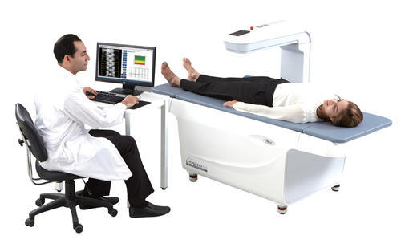
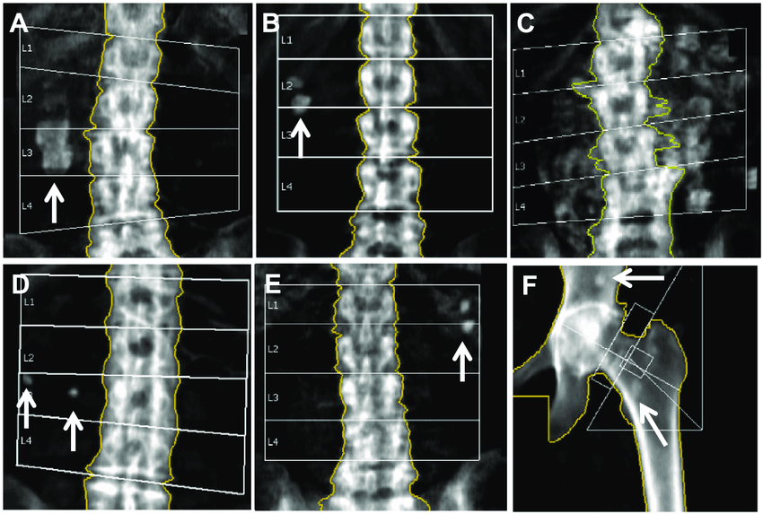
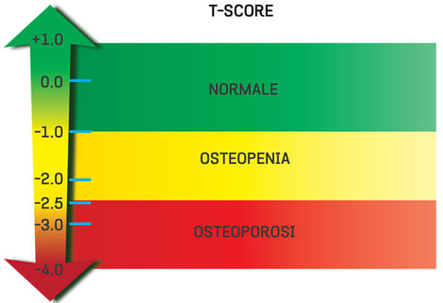
Introduction - Biology/Physiology
Current methods
Bone density scans, also known as DEXA scans, help to work out risk of breaking a bone.[2]
Bone Mineral Density (BMD) evaluation based on T-score (lower score = weaker bones)
Osteopenia - Osteoporosis occurs gradually usually without any symptoms
Frequent fractures and weakness causes patients to receive diagnosis and by that time it's too late

Slide 4
Risk Factors
Risk factors associated with increased osteoporosis chance
Lifestyle habits(Exercise, Diet, smoking, alcohol) [11]
Gender [3]
Age [4]
BMI [5]
Ethnicity & Race [6]
Maternal History of Fractures [8]
History of Fractures [8]
Grip Strength [9]
Vitamin Deficiency [10]
Each of these risk factors were graded by their researched association with successful diagnosis of osteoporosis
Age, gender, and history of fractures are weighed heavier than ethnicity or smoking

Slide 5
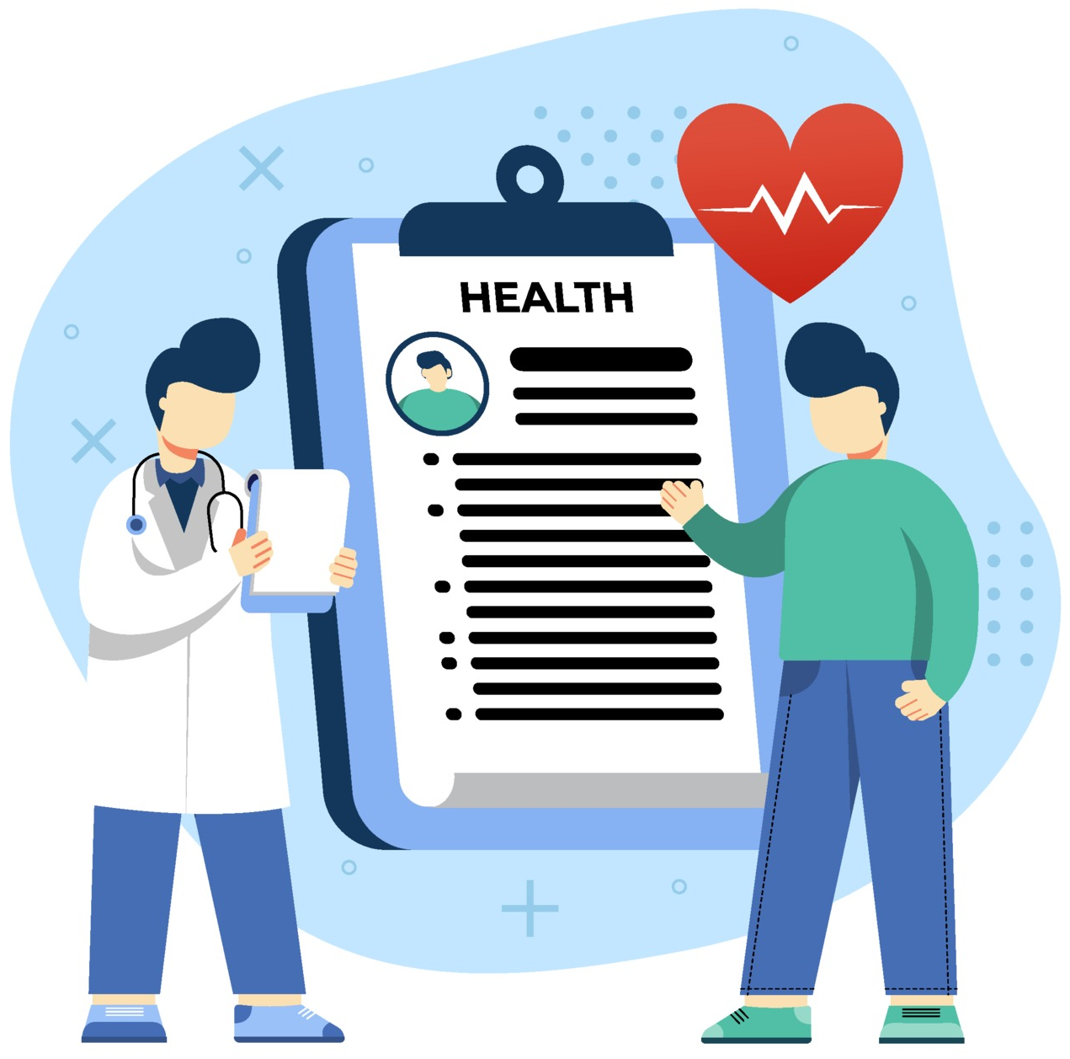
Introduction - Goals
Objective/Goal - The authors hope to assist the user to evaluate patients' risk of osteoporosis without the need for expensive and invasive procedures as a preliminary discovery method.
Output - Pie chart showing series of percentages of diagnosed patients with similar risk factors; having osteoporosis (Yes), not having osteoporosis (No), and an uncertainty percentage (Unknown) that instructs the user for further assessment of the patient.
End Users - Primary users are physicians or healthcare professionals.
Use Cases - This method would be used to assess risk factors associated with osteoporosis to determine need for further testing/diagnosis.
Success - Success will depend on the reliability of the database and the certainty in predicting risk before it's too late. It will influence our understanding/medical practice by having the ability to perform a quick and easy UI to expand access for preliminary diagnosis. The predictor will improve with greater sample sizes and user bases and expand scientific knowledge of osteoporosis.

Slide 6
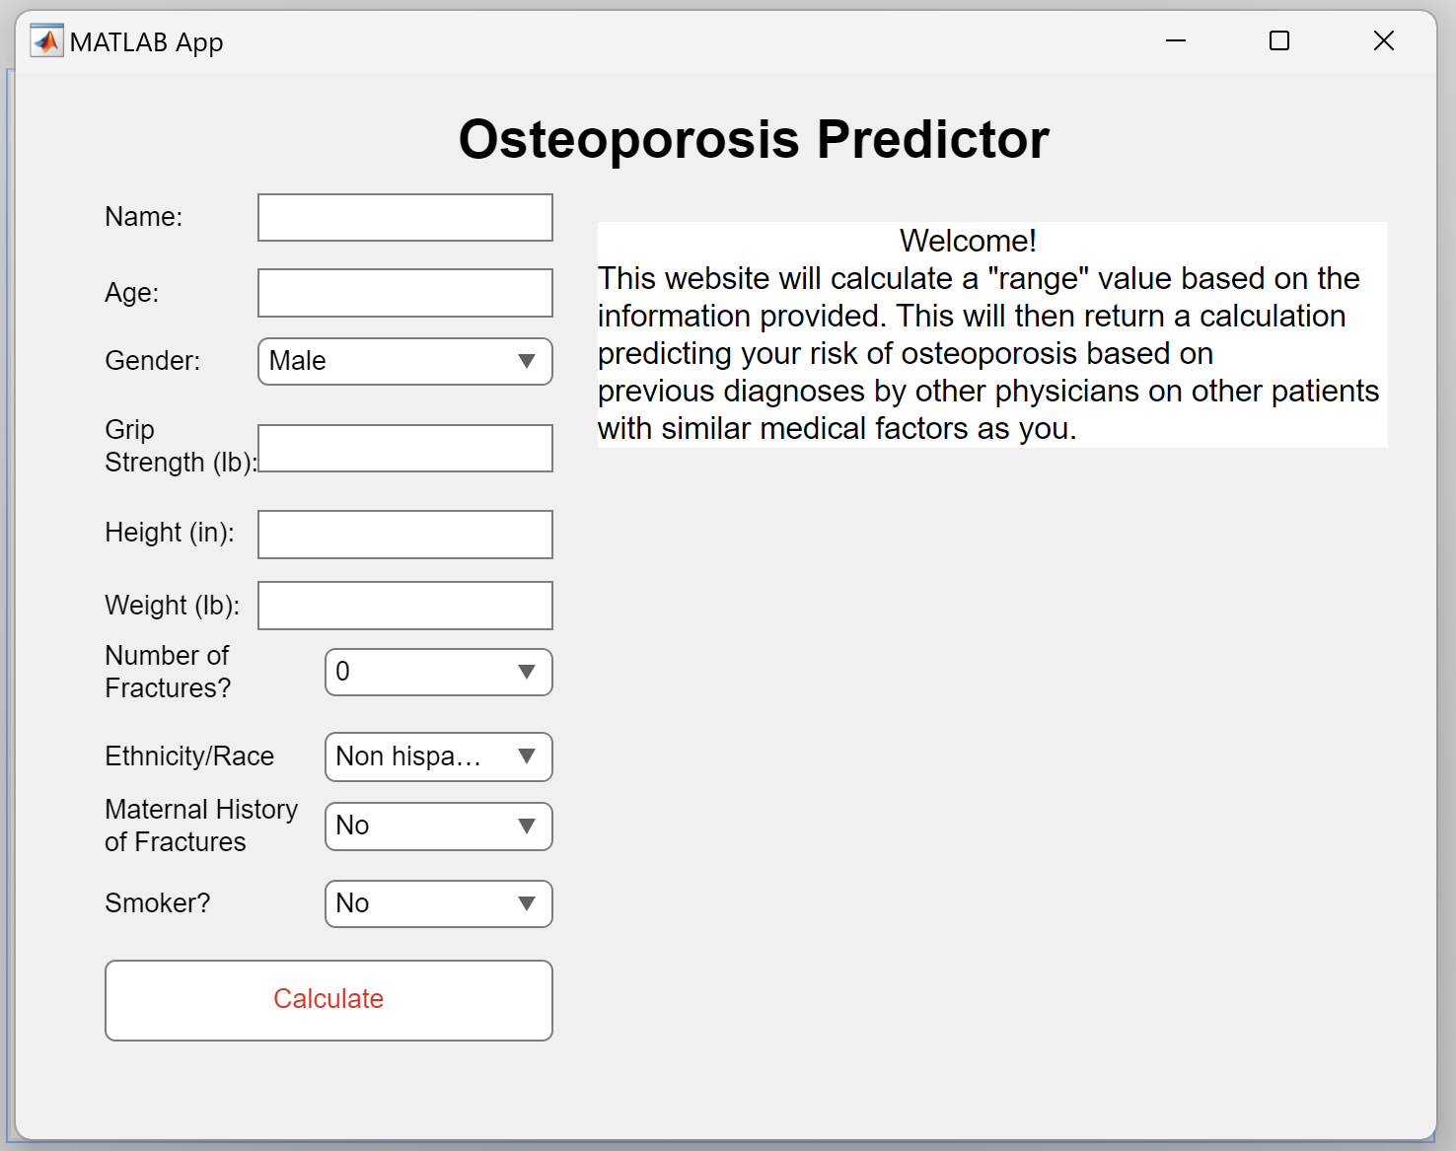
Experiments and Methods
Surveys/Datasets
Dataset criteria based on research papers and abstracts
Software Used
GUI was created by MATLAB App Designer
Used SQLite to create the database
Calculated the prediction using a MATLAB Function which was linked to both the GUI and the database
Methods/Analysis Workflow
K-means calculation of nearest neighbor
Patient diagnosis based on a distance score calculated via k-means
Score compared to database patients who were formally diagnosed by healthcare professionals
New patient results and information inputted back into database for growth and improvement

Slide 7
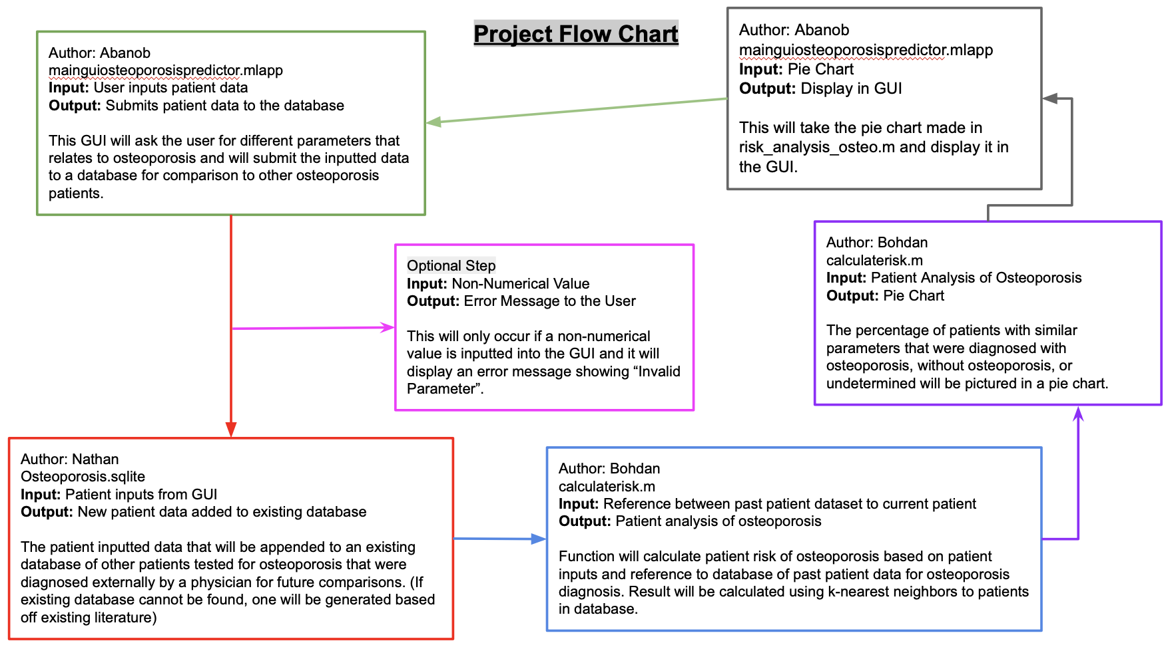
Experiments and Methods - Project Flow Chart

Slide 8
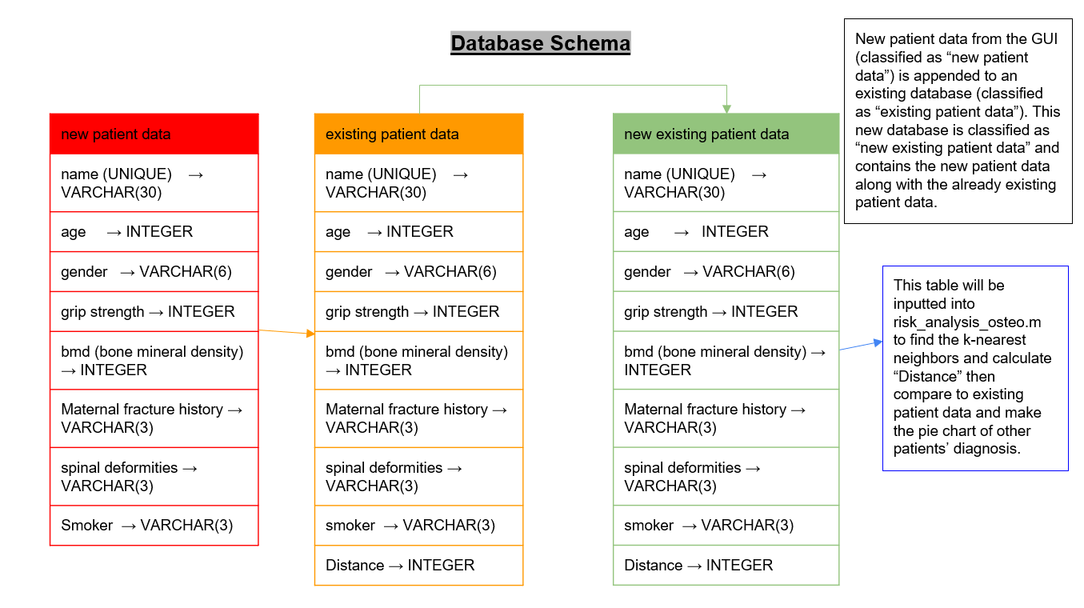
Experiments and Methods - ER Diagram

Slide 9
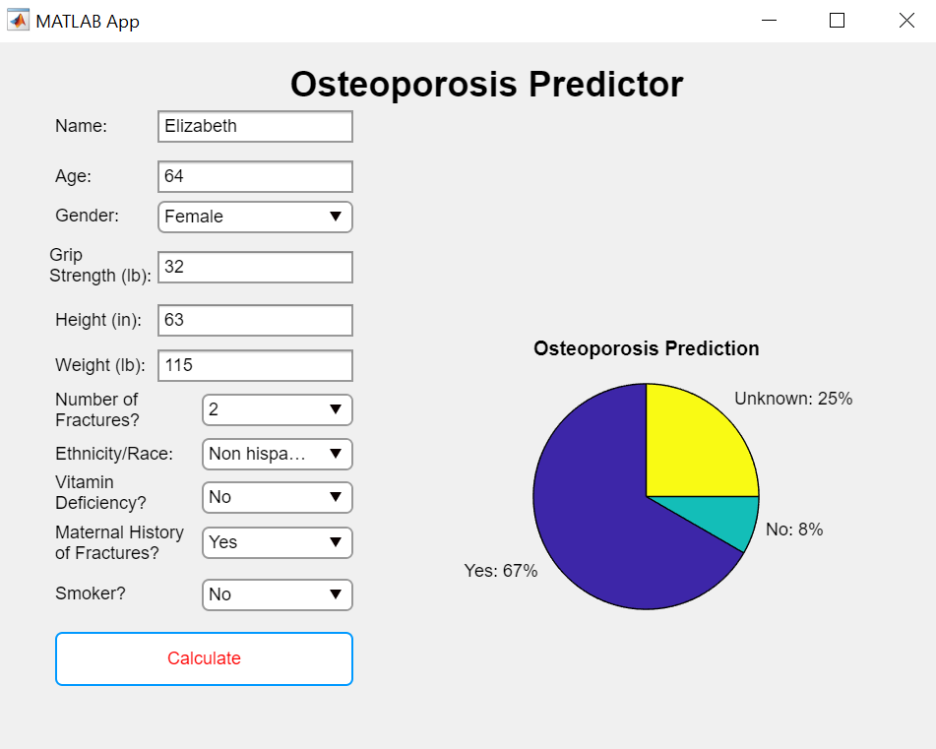
Results
—Demonstration—
Results shows a pie chart figure with three percentages.
Yes - Chances of having Osteoporosis prior to diagnosis
No - Chances of not having Osteoporosis prior to diagnosis
Unknown - Error within the system and limitation of available patient data
If certain thresholds are reached, the healthcare professional can recommend lifestyle changes or insist on a further analysis for a better evaluation.
App highlights urgency and need for routine check-ups and testing (DEXA)

Slide 10
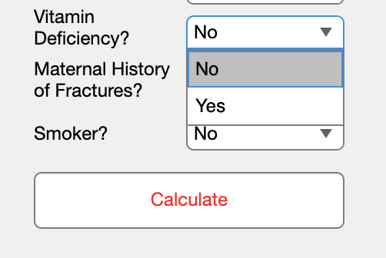
Discussion
Limitations
Heavily reliant on patient data and existing information on osteoporosis
Cannot give definite risk can only access it and show a prediction for certain categorical changes (yes, no, unknown)
Assessment based on population data and not always a definite risk factor for each person (everyone is unique)
Has a limited number of questions with a limited number of answer choices
Some of the Dropdown menu questions is “yes” or “no” answer
No “unknown” option
Improvements
Include more criteria and survey questions for a more accurate risk measure
Assess risk over time by showing patient risk changes every time user updates patient status.
Include recommendations based on some criteria questions in the GUI such as diet changes or exercise.

Slide 11
Works Cited
https://www.bonehealthandosteoporosis.org/wp-content/uploads/2015/12/Osteoporosis-Fast-Facts.pdf
https://my.clevelandclinic.org/health/diagnostics/10683-dexa-dxa-scan-bone-density-test
https://dhhr.wv.gov/hpcd/FocusAreas/osteoporosis/Pages/Osteo-Risk-Factors.aspx
https://www.cdc.gov/nchs/products/databriefs/db405.htm#:~:text=The%20prevalence%20of%20low%20bone%20mass%2C%20a%20precursor%20of%20osteoporosis,compared%20with%20men%20(33.5%25).
https://www.ncbi.nlm.nih.gov/pmc/articles/PMC3811701/
https://www.ncbi.nlm.nih.gov/pmc/articles/PMC7652647/
https://journals.lww.com/jaaos/fulltext/2007/00001/racial_and_ethnic_differences_in_osteoporosis.8.aspx#:~:text=In%20addition%20to%20sex%20differences,women%20of%20the%20same%20age.
https://pubmed.ncbi.nlm.nih.gov/15542027/
https://pubmed.ncbi.nlm.nih.gov/32889572/
https://pubmed.ncbi.nlm.nih.gov/21872800/
https://www.mayoclinic.org/healthy-lifestyle/adult-health/in-depth/bone-health/art-20045060#:~:text=A%20diet%20low%20in%20calcium,Tobacco%20and%20alcohol%20use.

